Slide 1
WOMEN OBESITY
Writing Assignment 3

Slide 2
What is Obesity?
It is the condition of being grossly fat or overweight
Obesity affects not just appearance, but disease processes as well
It has been linked to a number of health risks, such as heart disease
In an adult, it is typically indicated by a body mass index of 30 or greater
According to WHO report in 2014, approx. 40% females in the world are obese, which has definitely grown in the last three years

Slide 3
Factors Contributing to Obesity
Genetics. Your genes may affect the amount of body fat you store, and where that fat is distributed
Family lifestyle
Inactivity
Unhealthy diet
Medical problems
Certain medications
Social and economic issues
Age

Slide 4
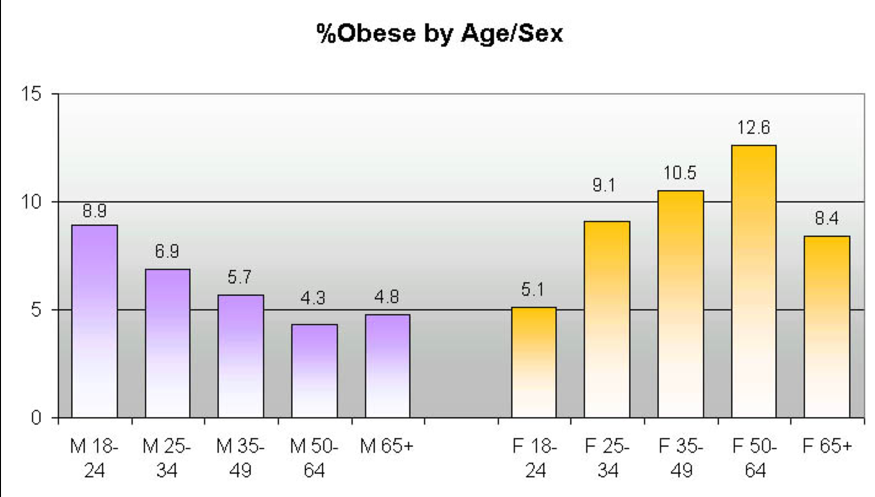
Female obesity ratio in USA

Slide 5

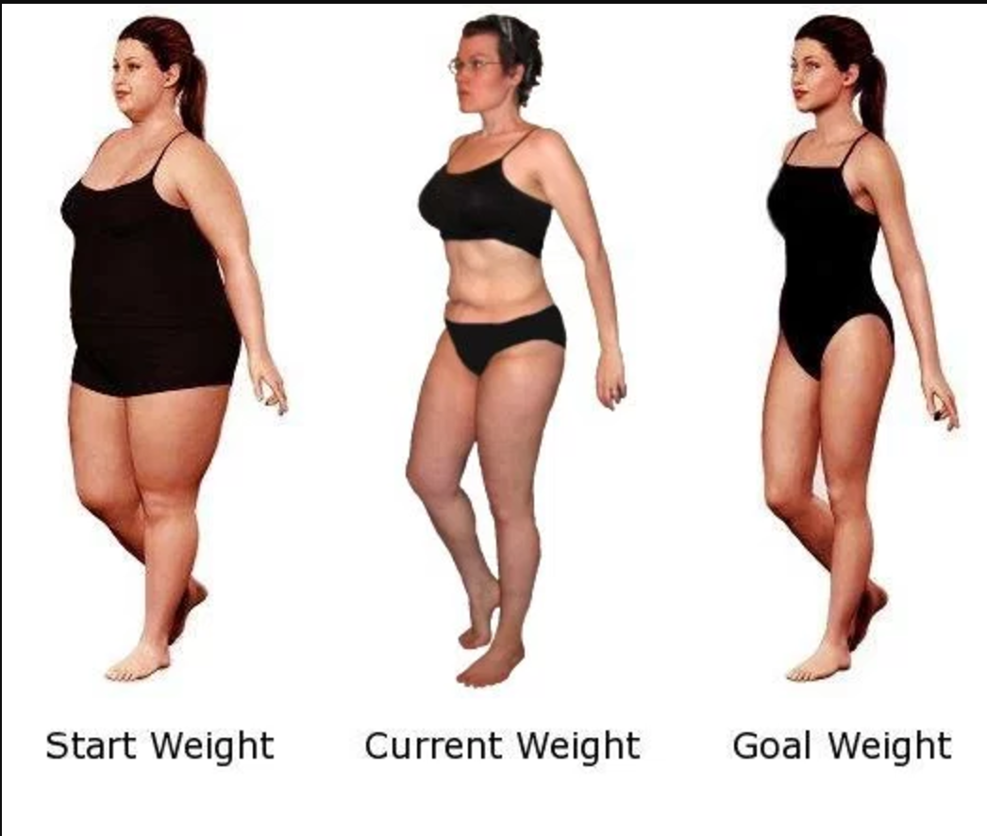
How to overcome Obesity?
Eat the right proportions
Get at least 60 min of physical activity
Drink more water
Eat a variety of food from all genres
Diet your way
Walk and Talk ;) [as women love talking]

Slide 6
Proposal by Amazon
“ I AM FIT” app
Applicable for all age groups in women
Focuses on improving health conditions in women
Provides a virtual trainer who properly guides in the workout routines as well as provides the correct diet depending on the female
Can reduce the overall obesity percentage in the women gender
Main motto “ I CAN, I WILL, I HAVE DONE IT” and thus motivates them towards their goal

